Slide 1
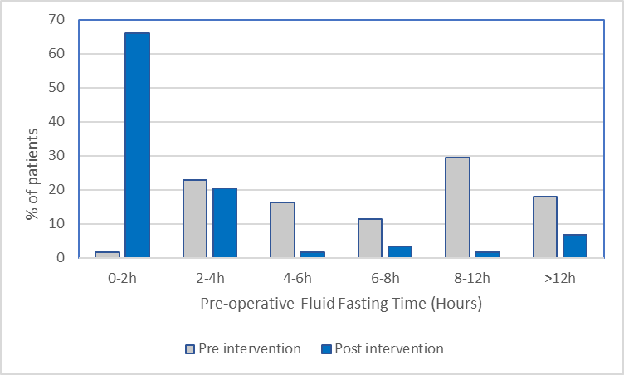
Successful Reduction of Prolonged Fasting Times in Cardiothoracic Surgery.
M.Madden*, M. Murray, M. Paguyo, E. Barker, J. Gan.
Royal Brompton Hospital, London.
Royal Brompton Hospital
Introduction
Results
International pre-operative fasting guidelines are well established; recommending a 2 hour fasting period for clear fluids in adults¹. Despite this, actual fasting periods are many times in excess of the recommended time.
Evidence shows that incidence of pulmonary aspiration and associated morbidity is rare². Prolonged fasting times however can lead to adverse effects such as dehydration, anxiety, post operative nausea and vomiting, metabolic derangements and delirium^{3,4}.
In the drive to optimise peri-operative care, there is a growing movement to reduce excessive fasting times. Here we present the implementation of a ‘Sip Til Send’ Quality Improvement initiative in a tertiary London Cardio-thoracic centre.
Baseline data (n=61) showed a median fluid fasting time of 7.6 hours (IQR 4.2-11.0 hours). Two months following the roll out of ‘Sip Til Send’, fasting times were re-audited (n=59). This showed a reduction of median fluid fasting time to 1.4 hours (IQR 0.8-2.3 hours). The distribution of fasting times pre, and post intervention is displayed in Figure 3.
Patients were asked to score their thirst from 1 (no thirst) to 10 (maximum thirst). Baseline data showed a median score of 7. This was reduced to a median score of 5 after the introduction of ‘Sip Til Send’. All patients reported their fasting instructions were clearly communicated to them.
No adverse events or concerns were reported by the anaesthetic or surgical teams during the audit period. Longer term monitoring of potential resultant adverse events is currently being conducted, in line with our QIP process.
Survey data was collected from nursing staff following the educational sessions. 93% of nursing staff found the educational sessions useful. No concerns from nursing staff were reported.
Figure 3. Distribution of Fasting Time for Fluids prior to, and after, the introduction of the 'Sip Til Send’ policy.
Conclusion
Methods
We have demonstrated a successful reduction fasting time for clear fluids times in an adult cardiothoracic patient cohort. This success was underpinned by collaborative, multi-dimensional team working, ranging from catering staff to all levels of ward and theatre staff.
We plan to repeat data collection and subsequent interventions in line with a Plan-Do-Cycle-Act approach to ensure sustained improvements and monitor for potential adverse events.
An adult ’Sip Til Send’ policy was devised following consultation and agreement of the anaesthetic department [Figure 1]. The timeline of implementation is as below [Figure 2]. An audit of baseline fasting data and following implementation was conducted for all elective cases. Emergency procedures were excluded from this policy. There was no change to fasting times for solids.
STUDY
Figure 1. The finalised ‘Sip Til Send’ guideline.
July 22
Baseline data collection of adult fasting times
Aug 22
Draft of adult Sip til Send policy
Sept 22
Policy finalization within the anaesthetic department
Sept 22
All stakeholders consulted regarding the policy
Educational sessions to ward nursing staff
Oct 22
Live roll-out of the Sip Til Send policy
Jan 23
[PDSA 1]
Repeat data collection of fasting times
Feb 23
Staff survey and feedback
March 23
Ongoing educational sessions to ward nursing staff
Acknowledgements
This QIP was registered with the Trust Clinical Audit department. We would like to thank all staff involved for their support in making this QIP possible.
References
1. Smith I, Kranke P, Murat I, et al. Perioperative fasting in adults and children: guidelines from the European Society of Anaesthesiology. European Journal of Anaesthesiology 2011; 28: 556–69.
2. T. M. Cook, N. Woodall, C. Frerk, A national survey of the impact of NAP4 on airway management practice in United Kingdom hospitals: closing the safety gap in anaesthesia, intensive care and the emergency department, Br J Anaesth. 2016 Aug;117(2): 182-190
3. Morrison CE, Ritchie-McLean S, Jha A, Mythen M. Two hours too long: time to review fasting guidelines for clear fluids. Br J Anaesth. 2020;124(4):363–66.
4. McCracken GC, Montgomery J. Postoperative nausea and vomiting after unrestricted clear fluids before day surgery: A retrospective analysis. Eur J Anaesthesiol. 2018 May;35(5):337-342.
Figure 2. Timeline displaying the process of the Quality Improvement Project (QIP).
*Correspondence to: mary.madden4@nhs.net
Notes:
Hi Mary
I have attached baseline audit data.
For all the data, I was thinking if we should convert everything to hours. Hard to grasp 420 mins, 7 hours is more stark to the viewers.
I don’t think we have PONV / Biochemical data for the poster
Can you change the graph from 3D to 2D? Easier to see
I think there is no need to bulk out the result as the moment. This is a poster, the headline should be that we have established ‘Sip till Send’ and it has worked to reduce fasting times.
Can you please send me the advert for poster submission?
I think in general, I have tried to reduce the number of words. This is to allow the graphs / timeline to feature more prominently.
Rather than proportion of patients with thirst score =>5, should we be comparing median thirst score instead? Need to explain that it is a numerical scale where 0 = not thirsty, 10 = worst thirst ever. What do you think?
Need to use a new logo which has GSTT somewhere in it.
Catch up with you tomorrow
Reduced residual gastric volume and reduced the gastric pH
Anaesthetic charts were updated to include a tick box for ‘Sip Til Send’ in the fasting instructions.
Laminated placards were placed by the patients bedside to display either ‘Sip til Send” or “Nil by Mouth” to inform ward and catering staff; allowing jugs of water and a glass by the bedside to be supplied.
Outcome Measure –
Process Measure –
Process Measure –

